Slide 1
Artificial Intelligence
Techniques in
Manufacturing

Slide 2
Machine Learning: State of the Art
Data | Type | Examples
Inhomogeneous Data | Gradient Boosting Machine | XGBoost CatBoost LightGBM
Homogeneous Data | Artificial Neural Network | Deep Neural Network Convolutional Neural Network Long Short-Term Memory Neural Network Transformer Network

Slide 3
Artificial Neural Network

Slide 4
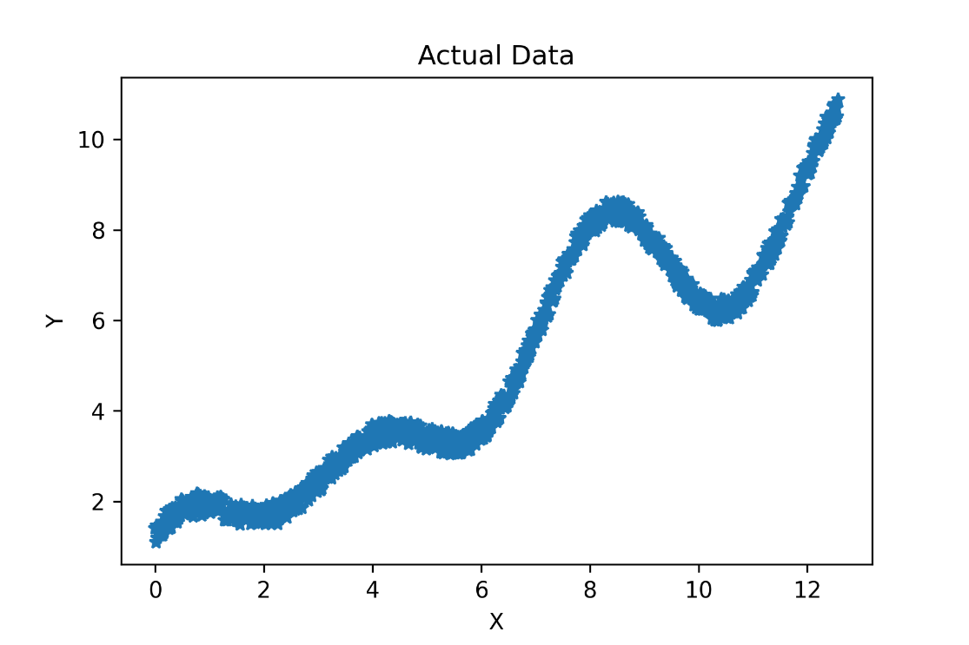
How do we fit a line to this data?

Slide 5
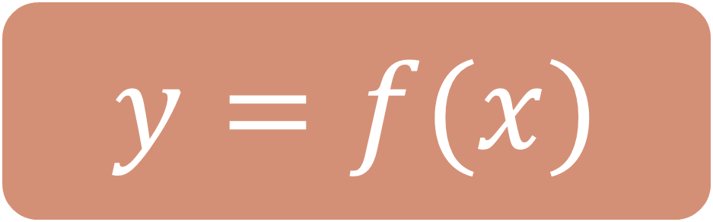
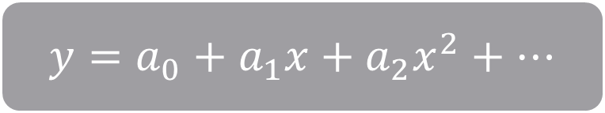
$$y=f(x)$$
$$y=a_{0}+a_{1}x+a_{2}x^{2}+…$$

Slide 6
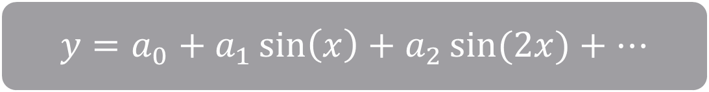
$$y=f(x)$$
$$y=a_{0}+a_{1}x+a_{2}x^{2}+…$$
$$y=a_{0}+a_{1}\sin\left(x\right)+a_{2}\sin{(2x)}+…$$

Slide 7

$$y=f(x)$$
$$y=a_{0}+a_{1}x+a_{2}x^{2}+…$$
$$y=a_{0}+a_{1}\sin\left(x\right)+a_{2}\sin{(2x)}+…$$
$$\text{Artificial} \text{Neural} \text{Network}$$
Universal Approximator

Slide 8

Artificial Neural Network

Slide 9
Artificial Neural Network
Regularization
Kernel Types
Optimization Technique
Activation Functions
Network Architecture

Slide 10
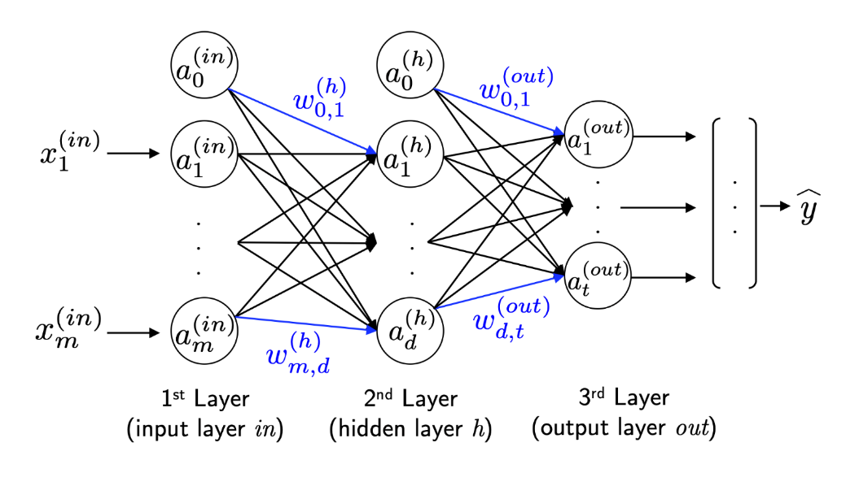
Connection to Biological Neural Networks
This connection is not relevant nowadays.

Slide 11
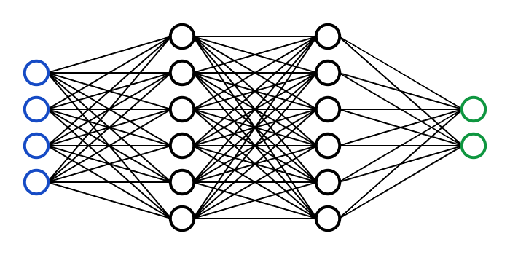
Architecture
Node
Input Layer
1st Hidden Layer
2nd Hidden Layer
Output Layer

Slide 12





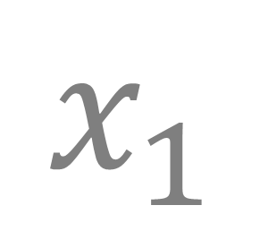

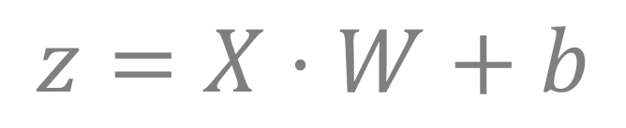

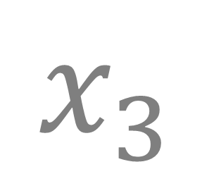

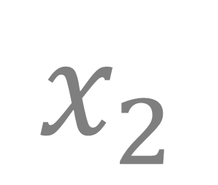

Hidden Node
$$w_{1},w_{2},w_{3}$$
$$b$$
Weights
Bias
$$φ$$
$$x_{1}$$
$$z$$
$$Σ$$
$$φ$$
$$φ$$
$$x_{2}$$
$$φ$$
$$x_{3}$$
Net Input Function
Activation Function
$$z=X⋅W+b$$
$$φ=φ(z)$$
Input
Output

Slide 13
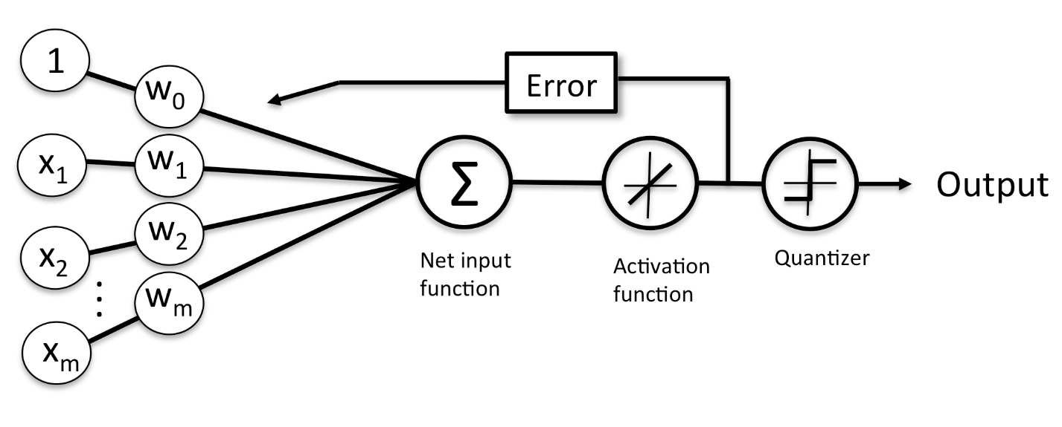

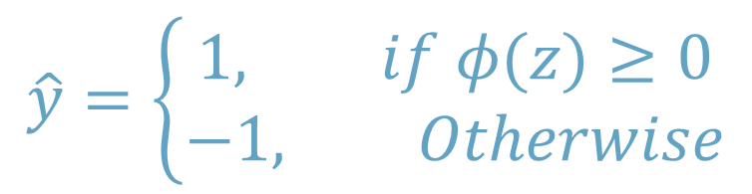

Compared with Perceptron
$$\hat{y}=\left\{\begin{aligned}1, if φ(z)≥0 \\ −1, Otherwise\end{aligned}\right.$$
$$z=X⋅W$$
$$φ(z)=z$$

Slide 14
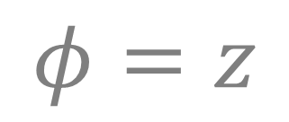





Input Node
$$w=1$$
$$b=0$$
$$z$$
$$x$$
$$Σ$$
$$φ$$
$$φ=x$$
Single Input
Single Output
Net Input Function
Activation Function
$$z=x$$
$$φ=z$$

Slide 15
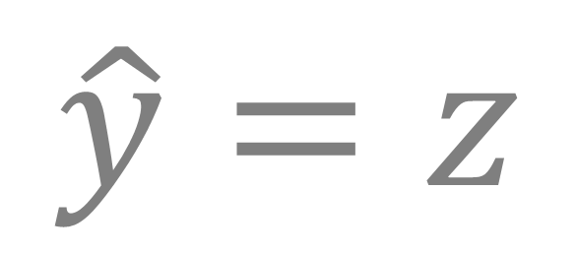
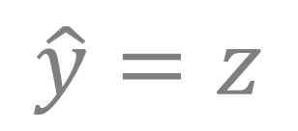
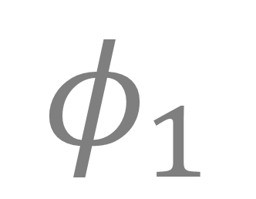
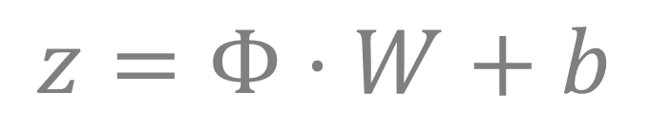
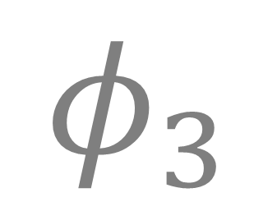

Output Node
$$w_{1},w_{2},w_{3}$$
$$b$$
Weights
Bias
$$φ_{1}$$
$$z$$
$$φ$$
$$\hat{y}=z$$
$$φ_{2}$$
$$Σ$$
Single Output
$$φ_{3}$$
Net Input Function
Activation Function
$$z=Φ⋅W+b$$
$$\hat{y}=z$$
Input

Slide 16

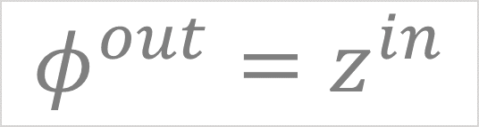










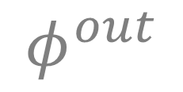
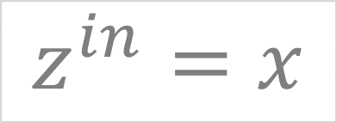
Input Layer
Output Layer
$$w^{out}, b^{out}$$
$$z^{in}$$
$$φ^{out}$$
$$z^{out}$$
$$x$$
$$Σ$$
$$φ$$
$$Σ$$
$$φ$$
$$\hat{y}$$
$$z^{in}=x$$
$$φ^{out}=z^{in}$$
$$z^{out}=w^{out}φ^{out}+b^{out}$$
$$\hat{y}=z^{out}$$
$$\hat{y}=w^{out}x+b^{out}$$

Slide 17
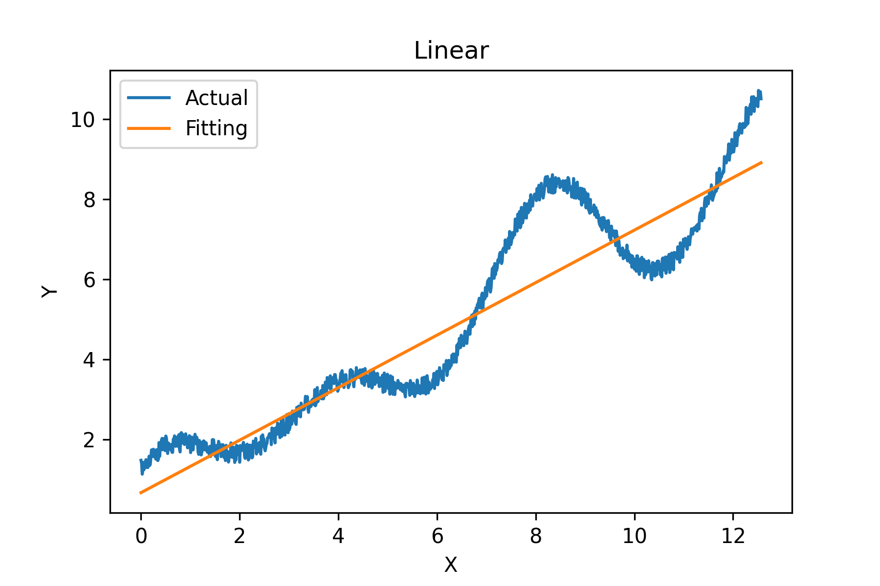
#Parameters: 2

Slide 18

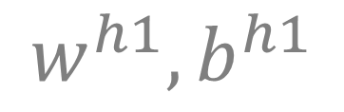


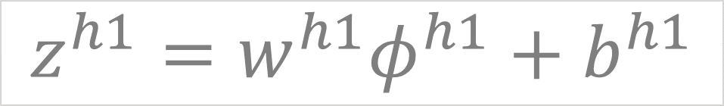




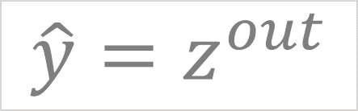
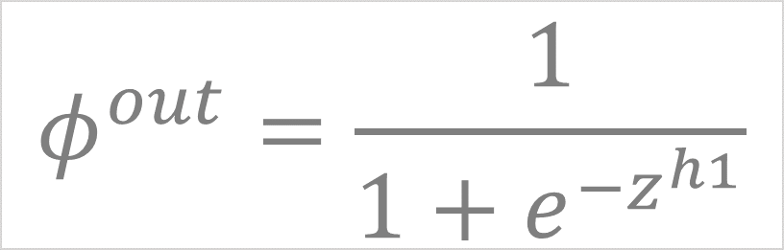



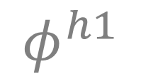





Input Layer
Hidden Layer
Output Layer
$$w^{h1}, b^{h1}$$
$$w^{out}, b^{out}$$
$$x$$
$$Σ$$
$$z^{in}$$
$$φ$$
$$φ^{h1}$$
$$Σ$$
$$z^{h1}$$
$$φ$$
$$φ^{out}$$
$$Σ$$
$$z^{out}$$
$$φ$$
$$\hat{y}$$
$$z^{in}=x$$
$$z^{h1}=w^{h1}φ^{h1}+b^{h1}$$
$$z^{out}=w^{out}φ^{out}+b^{out}$$
$$φ^{out}=\frac{1}{1+e^{−z^{h1}}}$$
$$\hat{y}=z^{out}$$
$$φ^{h1}=z^{in}$$
Sigmoid Function

Slide 19

Input Layer
Hidden Layer
Output Layer
$$w^{h1}, b^{h1}$$
$$w^{out}, b^{out}$$
$$x$$
$$Σ$$
$$z^{in}$$
$$φ$$
$$φ^{h1}$$
$$Σ$$
$$z^{h1}$$
$$φ$$
$$φ^{out}$$
$$Σ$$
$$z^{out}$$
$$φ$$
$$\hat{y}$$
$$\hat{y}=w^{out}\left[\frac{1}{1+e^{−{(w}^{h1}x+b^{h1})}}\right]+b^{out}$$

Slide 20
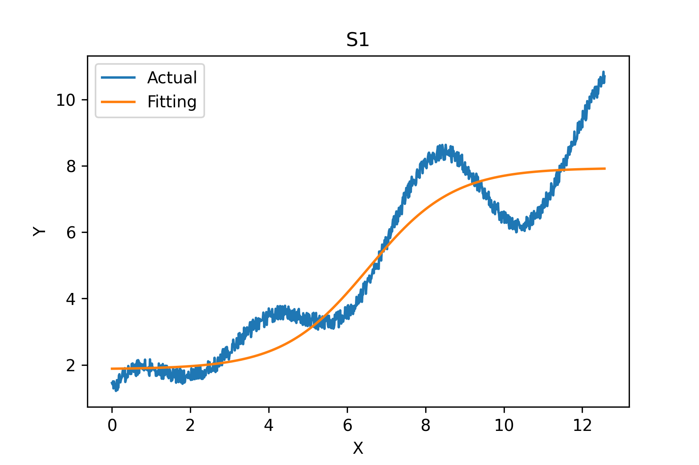
#Parameters: 4

Slide 21





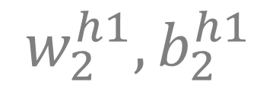

$$w_{1}^{h1}, b_{1}^{h1}$$
1
$$w_{2}^{h1}, b_{2}^{h1}$$
$$w_{1}^{out},w_{2}^{out}…,w_{10}^{out} , b^{out}$$
$$x$$
In
2
Out
$$\hat{y}$$
…
$$w_{10}^{h1}, b_{10}^{h1}$$
10
$$\hat{y}=Σ_{i=1}^{10}\left[w_{i}^{out}\frac{1}{1+e^{−{(w}_{i}^{h1}x+b_{i}^{h1})}}\right]+b^{out}$$

Slide 22
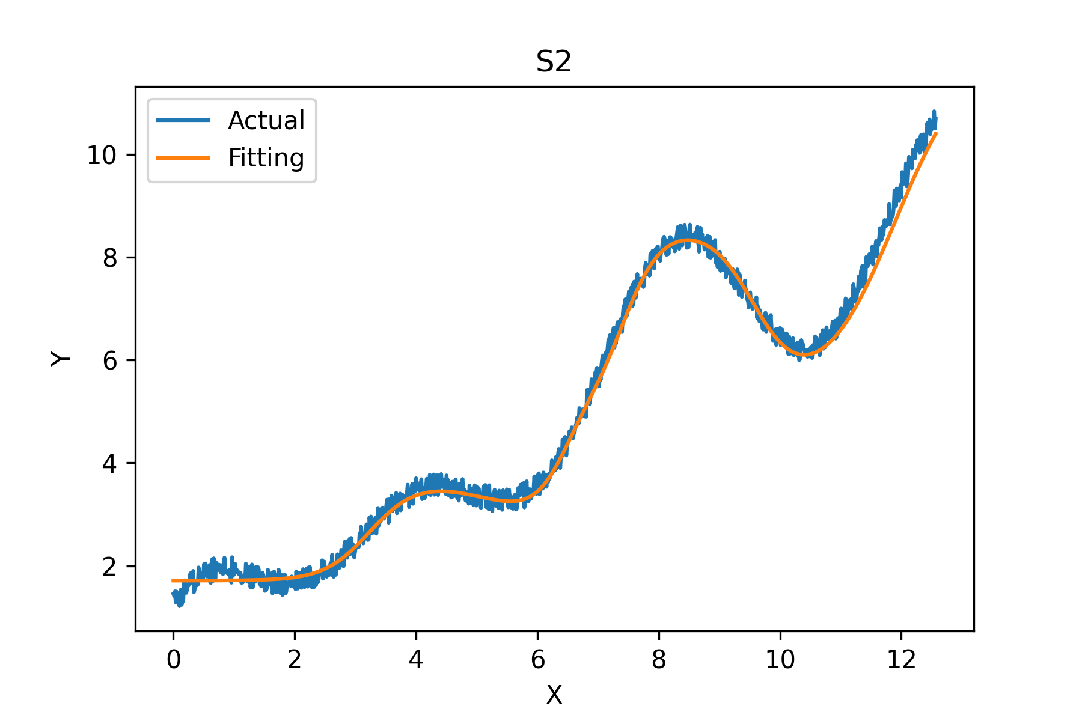
#Parameters: 31

Slide 23
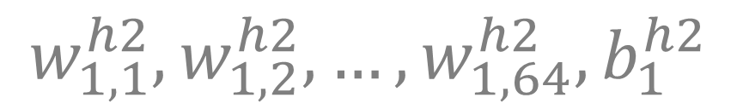




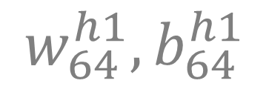
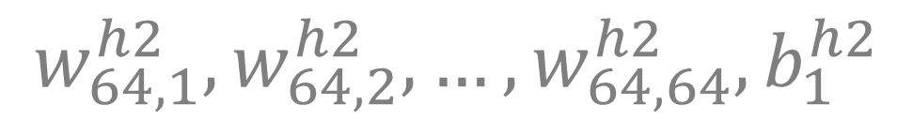

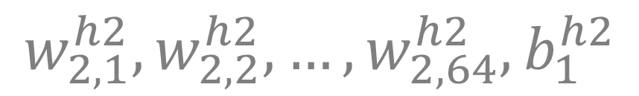
$$w_{1}^{h1}, b_{1}^{h1}$$
$$w_{1,1}^{h2},w_{1,2}^{h2},…,w_{1,64}^{h2}, b_{1}^{h2}$$
1
1
$$w_{1}^{out},w_{2}^{out}…,w_{64}^{out} , b^{out}$$
$$w_{2}^{h1}, b_{2}^{h1}$$
$$w_{2,1}^{h2},w_{2,2}^{h2},…,w_{2,64}^{h2}, b_{1}^{h2}$$
In
2
2
Out
$$x$$
$$\hat{y}$$
…
…
$$w_{64}^{h1}, b_{64}^{h1}$$
$$w_{64,1}^{h2},w_{64,2}^{h2},…,w_{64,64}^{h2}, b_{1}^{h2}$$
64
64
128
4160
65
Parameters
Parameters
Parameters

Slide 24
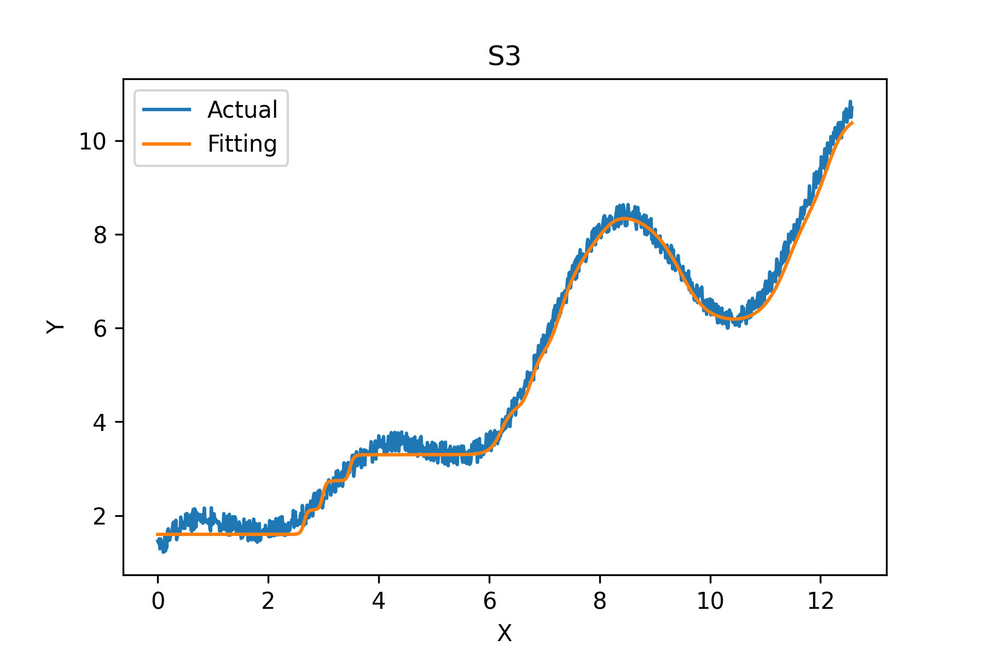
#Parameters: 4,353

Slide 25


Deep Neural Network
256
256
128
64
In
32
Out
$$x$$
16
$$\hat{y}$$

Slide 26
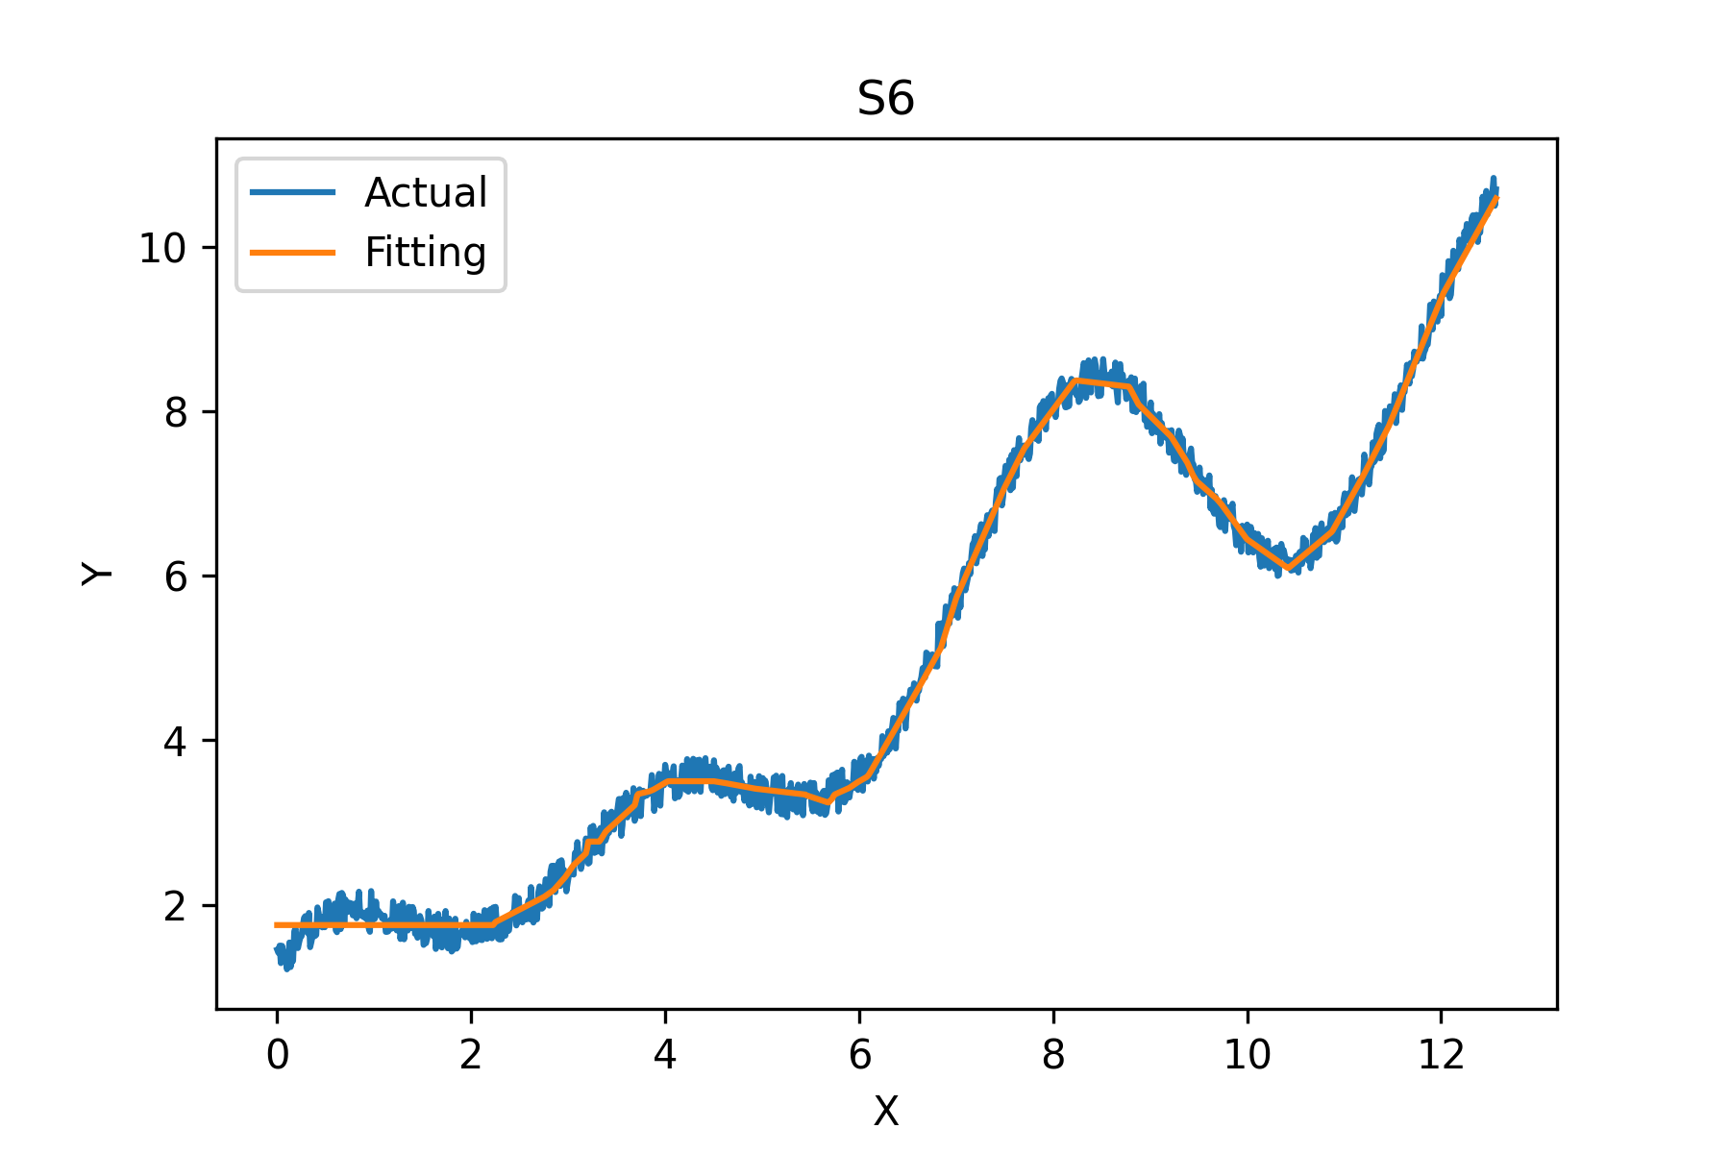
#Parameters: 110,081

Slide 27
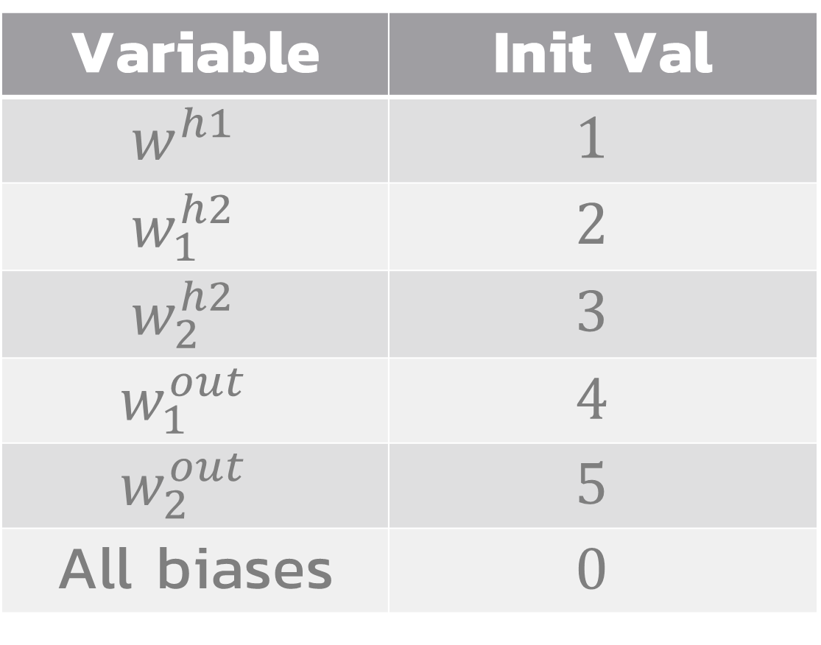
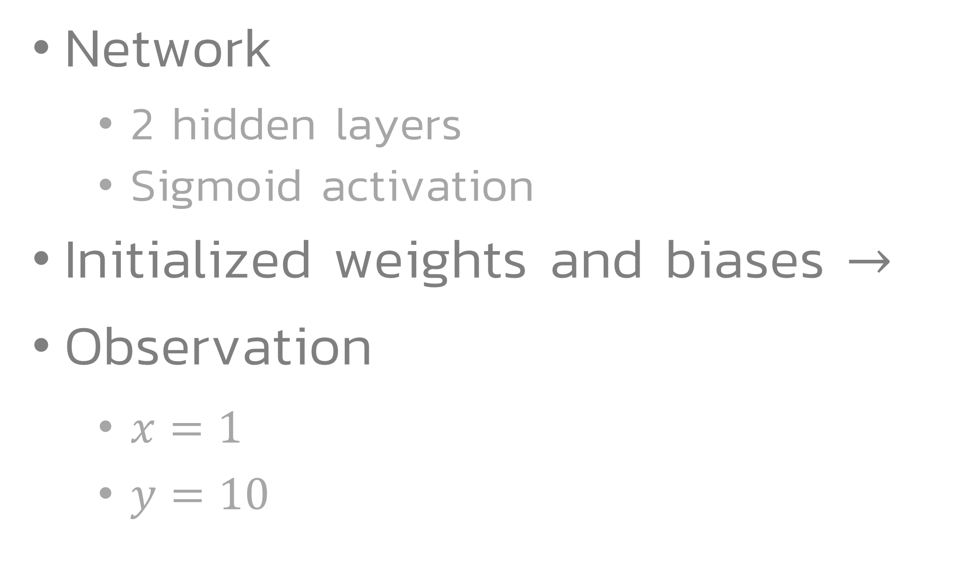
Prediction
h2-1
In
h1
Out
h2-2
Network
2 hidden layers
Sigmoid activation
Initialized weights and biases $→$
Observation
$x=1$
$y=10$
Variable | Init Val
$$w^{h1}$$ | $$1$$
$$w_{1}^{h2}$$ | $$2$$
$$w_{2}^{h2}$$ | $$3$$
$$w_{1}^{out}$$ | $$4$$
$$w_{2}^{out}$$ | $$5$$
All biases | $$0$$

Slide 28









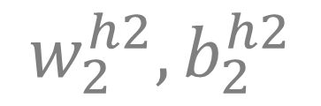





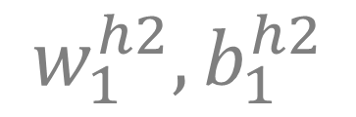










$$x$$
$$w_{1}^{out},w_{2}^{out}, b^{out}$$
$$z^{in}$$
$$Σ$$
$$φ$$
$$w_{1}^{h2}, b_{1}^{h2}$$
$$Σ$$
$$z^{out}$$
$$φ$$
$$φ_{1}^{out}$$
Input Layer
$$z_{1}^{h2}$$
$$Σ$$
$$φ$$
$$φ^{h1}$$
$$w^{h1}, b^{h1}$$
Output Layer
$$φ^{h2}$$
$$z^{in}$$
$$φ$$
$$Σ$$
$$φ_{2}^{out}$$
$$w_{2}^{h2}, b_{2}^{h2}$$
$$\hat{y}$$
$$φ^{h2}$$
$$z_{2}^{h2}$$
Hidden Layer 1
$$Σ$$
$$φ$$
Hidden Layer 2

Slide 29


$$x$$
$$1$$
$$w_{1}^{out},w_{2}^{out}, b^{out}$$
$$z^{in}$$
$$Σ$$
$$φ$$
$$w_{1}^{h2}, b_{1}^{h2}$$
$$Σ$$
$$z^{out}$$
$$φ$$
$$φ_{1}^{out}$$
$$z_{1}^{h2}$$
$$Σ$$
$$φ$$
$$φ^{h1}$$
$$w^{h1}, b^{h1}$$
$$φ^{h2}$$
$$z^{in}$$
$$φ$$
$$Σ$$
$$φ_{2}^{out}$$
$$w_{2}^{h2}, b_{2}^{h2}$$
$$\hat{y}$$
$$φ^{h2}$$
$$z_{2}^{h2}$$
$$Σ$$
$$φ$$
Variable | Init. Val
$$w^{h1}$$ | $$1$$
$$w_{1}^{h2}$$ | $$2$$
$$w_{2}^{h2}$$ | $$3$$
$$w_{1}^{out}$$ | $$4$$
$$w_{2}^{out}$$ | $$5$$
All biases | $$0$$

Slide 30



$$x$$
$$1$$
$$w_{1}^{out},w_{2}^{out}, b^{out}$$
$$z^{in}$$
$$Σ$$
$$φ$$
$$1$$
$$w_{1}^{h2}, b_{1}^{h2}$$
$$Σ$$
$$z^{out}$$
$$φ$$
$$φ_{1}^{out}$$
$$z_{1}^{h2}$$
$$Σ$$
$$φ$$
$$φ^{h1}$$
$$w^{h1}, b^{h1}$$
$$φ^{h2}$$
$$z^{in}$$
$$φ$$
$$Σ$$
$$φ_{2}^{out}$$
$$w_{2}^{h2}, b_{2}^{h2}$$
$$\hat{y}$$
$$φ^{h2}$$
$$z_{2}^{h2}$$
$$Σ$$
$$φ$$
Variable | Init. Val
$$w^{h1}$$ | $$1$$
$$w_{1}^{h2}$$ | $$2$$
$$w_{2}^{h2}$$ | $$3$$
$$w_{1}^{out}$$ | $$4$$
$$w_{2}^{out}$$ | $$5$$
All biases | $$0$$
$$z^{in}=x$$

Slide 31



$$x$$
$$1$$
$$w_{1}^{out},w_{2}^{out}, b^{out}$$
$$z^{in}$$
$$Σ$$
$$φ$$
$$1$$
$$w_{1}^{h2}, b_{1}^{h2}$$
$$Σ$$
$$z^{out}$$
$$φ$$
$$φ_{1}^{out}$$
$$z_{1}^{h2}$$
$$1$$
$$Σ$$
$$φ$$
$$φ^{h1}$$
$$w^{h1}, b^{h1}$$
$$φ^{h2}$$
$$z^{in}$$
$$φ$$
$$Σ$$
$$φ_{2}^{out}$$
$$w_{2}^{h2}, b_{2}^{h2}$$
$$\hat{y}$$
$$φ^{h2}$$
$$z_{2}^{h2}$$
$$Σ$$
$$φ$$
Variable | Init. Val
$$w^{h1}$$ | $$1$$
$$w_{1}^{h2}$$ | $$2$$
$$w_{2}^{h2}$$ | $$3$$
$$w_{1}^{out}$$ | $$4$$
$$w_{2}^{out}$$ | $$5$$
All biases | $$0$$
$$φ^{h1}=z^{in}$$

Slide 32




$$x$$
$$1$$
$$w_{1}^{out},w_{2}^{out}, b^{out}$$
$$z^{in}$$
$$Σ$$
$$φ$$
$$1$$
$$w_{1}^{h2}, b_{1}^{h2}$$
$$Σ$$
$$z^{out}$$
$$φ$$
$$φ_{1}^{out}$$
$$z_{1}^{h2}$$
$$1$$
$$Σ$$
$$φ$$
$$φ^{h1}$$
$$w^{h1}, b^{h1}$$
$$φ^{h2}$$
$$z^{in}$$
$$φ$$
$$Σ$$
$$φ_{2}^{out}$$
$$1$$
$$w_{2}^{h2}, b_{2}^{h2}$$
$$\hat{y}$$
$$φ^{h2}$$
$$z_{2}^{h2}$$
$$Σ$$
$$φ$$
Variable | Init. Val
$$w^{h1}$$ | $$1$$
$$w_{1}^{h2}$$ | $$2$$
$$w_{2}^{h2}$$ | $$3$$
$$w_{1}^{out}$$ | $$4$$
$$w_{2}^{out}$$ | $$5$$
All biases | $$0$$
$$z^{in}=w^{h1}φ^{h1}+b^{h1}$$
$$z^{in}=1×1+0=1$$

Slide 33





$$x$$
$$1$$
$$w_{1}^{out},w_{2}^{out}, b^{out}$$
$$z^{in}$$
$$Σ$$
$$φ$$
$$1$$
$$w_{1}^{h2}, b_{1}^{h2}$$
$$Σ$$
$$z^{out}$$
$$φ$$
$$φ_{1}^{out}$$
$$z_{1}^{h2}$$
$$1$$
$$Σ$$
$$φ$$
$$φ^{h1}$$
$$w^{h1}, b^{h1}$$
$$0.731$$
$$φ^{h2}$$
$$z^{in}$$
$$φ$$
$$Σ$$
$$φ_{2}^{out}$$
$$1$$
$$w_{2}^{h2}, b_{2}^{h2}$$
$$0.731$$
$$\hat{y}$$
$$φ^{h2}$$
$$z_{2}^{h2}$$
$$Σ$$
$$φ$$
Variable | Init. Val
$$w^{h1}$$ | $$1$$
$$w_{1}^{h2}$$ | $$2$$
$$w_{2}^{h2}$$ | $$3$$
$$w_{1}^{out}$$ | $$4$$
$$w_{2}^{out}$$ | $$5$$
All biases | $$0$$
$$φ^{h2}=\frac{1}{1+e^{−z^{in}}}$$
$$φ^{h2}=\frac{1}{1+e^{−1}}=0.731$$

Slide 34








$$x$$
$$1$$
$$w_{1}^{out},w_{2}^{out}, b^{out}$$
$$z^{in}$$
$$Σ$$
$$φ$$
$$1$$
$$w_{1}^{h2}, b_{1}^{h2}$$
$$Σ$$
$$z^{out}$$
$$φ$$
$$φ_{1}^{out}$$
$$z_{1}^{h2}$$
$$1$$
$$Σ$$
$$φ$$
$$φ^{h1}$$
$$w^{h1}, b^{h1}$$
$$1.462$$
$$0.731$$
$$φ^{h2}$$
$$z^{in}$$
$$φ$$
$$Σ$$
$$φ_{2}^{out}$$
$$1$$
$$w_{2}^{h2}, b_{2}^{h2}$$
$$0.731$$
$$\hat{y}$$
$$φ^{h2}$$
$$z_{2}^{h2}$$
$$Σ$$
$$φ$$
Variable | Init. Val
$$w^{h1}$$ | $$1$$
$$w_{1}^{h2}$$ | $$2$$
$$w_{2}^{h2}$$ | $$3$$
$$w_{1}^{out}$$ | $$4$$
$$w_{2}^{out}$$ | $$5$$
All biases | $$0$$
$$2.193$$
$$z_{1}^{h2}=w_{1}^{h2}φ^{h2}+b_{1}^{h2}$$
$$z_{2}^{h2}=w_{2}^{h2}φ^{h2}+b_{2}^{h2}$$
$$z_{1}^{h2}=2×0.731+0=1.462$$
$$z_{2}^{h2}=3×0.731+0=2.193$$

Slide 35






$$x$$
$$1$$
$$w_{1}^{out},w_{2}^{out}, b^{out}$$
$$z^{in}$$
$$Σ$$
$$φ$$
$$1$$
$$w_{1}^{h2}, b_{1}^{h2}$$
$$Σ$$
$$z^{out}$$
$$φ$$
$$φ_{1}^{out}$$
$$z_{1}^{h2}$$
$$1$$
$$Σ$$
$$φ$$
$$0.811$$
$$φ^{h1}$$
$$w^{h1}, b^{h1}$$
$$1.462$$
$$0.731$$
$$φ^{h2}$$
$$0.899$$
$$z^{in}$$
$$φ$$
$$Σ$$
$$φ_{2}^{out}$$
$$1$$
$$w_{2}^{h2}, b_{2}^{h2}$$
$$0.731$$
$$\hat{y}$$
$$φ^{h2}$$
$$z_{2}^{h2}$$
$$Σ$$
$$φ$$
Variable | Init. Val
$$w^{h1}$$ | $$1$$
$$w_{1}^{h2}$$ | $$2$$
$$w_{2}^{h2}$$ | $$3$$
$$w_{1}^{out}$$ | $$4$$
$$w_{2}^{out}$$ | $$5$$
All biases | $$0$$
$$2.193$$
$$φ_{1}^{out}=\frac{1}{1+e^{−z_{1}^{h2}}}$$
$$φ_{2}^{out}=\frac{1}{1+e^{−z_{2}^{h2}}}$$

Slide 36




$$x$$
$$1$$
$$w_{1}^{out},w_{2}^{out}, b^{out}$$
$$z^{in}$$
$$Σ$$
$$φ$$
$$1$$
$$w_{1}^{h2}, b_{1}^{h2}$$
$$Σ$$
$$z^{out}$$
$$φ$$
$$φ_{1}^{out}$$
$$z_{1}^{h2}$$
$$7.745$$
$$1$$
$$Σ$$
$$φ$$
$$0.811$$
$$φ^{h1}$$
$$w^{h1}, b^{h1}$$
$$1.462$$
$$0.731$$
$$φ^{h2}$$
$$0.899$$
$$z^{in}$$
$$φ$$
$$Σ$$
$$φ_{2}^{out}$$
$$1$$
$$w_{2}^{h2}, b_{2}^{h2}$$
$$0.731$$
$$\hat{y}$$
$$φ^{h2}$$
$$z^{h2}$$
$$Σ$$
$$φ$$
Variable | Init. Val
$$w^{h1}$$ | $$1$$
$$w_{1}^{h2}$$ | $$2$$
$$w_{2}^{h2}$$ | $$3$$
$$w_{1}^{out}$$ | $$4$$
$$w_{2}^{out}$$ | $$5$$
All biases | $$0$$
$$2.193$$
$$z^{out}=w_{1}^{out}φ_{1}^{out}+w_{2}^{out}φ_{2}^{out}+b^{out}$$

Slide 37



$$x$$
$$1$$
$$w_{1}^{out},w_{2}^{out}, b^{out}$$
$$z^{in}$$
$$Σ$$
$$φ$$
$$1$$
$$w_{1}^{h2}, b_{1}^{h2}$$
$$Σ$$
$$z^{out}$$
$$φ$$
$$φ_{1}^{out}$$
$$z_{1}^{h2}$$
$$7.745$$
$$1$$
$$Σ$$
$$φ$$
$$0.811$$
$$φ^{h1}$$
$$w^{h1}, b^{h1}$$
$$1.462$$
$$0.731$$
$$φ^{h2}$$
$$0.899$$
$$7.745$$
$$z^{in}$$
$$φ$$
$$Σ$$
$$φ_{2}^{out}$$
$$1$$
$$w_{2}^{h2}, b_{2}^{h2}$$
$$0.731$$
$$\hat{y}$$
$$φ^{h2}$$
$$z_{2}^{h2}$$
$$Σ$$
$$φ$$
Variable | Init. Val
$$w^{h1}$$ | $$1$$
$$w_{1}^{h2}$$ | $$2$$
$$w_{2}^{h2}$$ | $$3$$
$$w_{1}^{out}$$ | $$4$$
$$w_{2}^{out}$$ | $$5$$
All biases | $$0$$
$$2.193$$
$$\hat{y}=z^{out}$$

Slide 38

Loss
Quantify how “bad” our model is.
Mean Square Error (MSE)
$L=\frac{1}{N}Σ_{i=1}^{N}{\left(y_{i}−{\hat{y}}_{i}\right)}^{2}$
In our example
$L={\left(10−7.745\right)}^{2}=5.082$

Slide 39
Parameter Update
Backpropagation
Base on chain rule
Computational graph
Compute input gradient signal at each node.
Send the gradient signal backward.

Slide 40






Computational Graph
$$a^{in}$$
$$f$$
$$a^{out}$$
$$g^{out}$$
$$g^{in}$$
$$g^{out}=g^{in}\frac{∂a^{out}}{∂a^{in}}$$

Slide 41









Computational Graph
$$g_{1}^{out}=g^{in}\frac{∂a^{out}}{∂a_{1}^{in}}$$
$$a_{1}^{in}$$
$$f$$
$$a^{out}$$
$$g_{1}^{out}$$
$$a_{2}^{in}$$
$$g^{in}$$
$$g_{2}^{out}=g^{in}\frac{∂a^{out}}{∂a_{2}^{in}}$$
$$g_{2}^{out}$$

Slide 42








Computational Graph
$$a_{1}^{out}$$
$$f$$
$$g_{1}^{in}$$
$$a^{in}$$
$$g^{out}$$
$$a_{2}^{out}$$
$$g_{2}^{in}$$
$$g^{out}=g_{1}^{in}\frac{∂a_{1}^{out}}{∂a^{in}}+g_{2}^{in}\frac{∂a_{2}^{out}}{∂a^{in}}$$

Slide 43





























$$w_{1}^{out},w_{2}^{out}, b^{out}$$
$$z^{in}$$
$$Σ$$
$$φ$$
$$w_{1}^{h2}, b_{1}^{h2}$$
$$Σ$$
$$z^{out}$$
$$φ$$
$$φ_{1}^{out}$$
$$z_{1}^{h2}$$
$$x$$
$$Σ$$
$$φ$$
$$φ^{h1}$$
$$w^{h1}, b^{h1}$$
$$\hat{y}$$
$$φ^{h2}$$
$$z^{in}$$
$$φ$$
$$L$$
$$Σ$$
$$φ_{2}^{out}$$
$$w_{2}^{h2}, b_{2}^{h2}$$
$$1$$
$$φ^{h2}$$
$$Σ$$
$$z_{2}^{h1}$$
$$φ$$
$$L$$
Add another “$L$” node with gradient input of $1$.

Slide 44




$$w_{1}^{out},w_{2}^{out}, b^{out}$$
$$z^{in}$$
$$Σ$$
$$φ$$
$$w_{1}^{h2}, b_{1}^{h2}$$
$$Σ$$
$$z^{out}$$
$$φ$$
$$φ_{1}^{out}$$
$$z_{1}^{h2}$$
$$x$$
$$Σ$$
$$φ$$
$$φ^{h1}$$
$$w^{h1}, b^{h1}$$
$$−4.508$$
$$\hat{y}$$
$$φ^{h2}$$
$$z^{in}$$
$$φ$$
$$L$$
$$Σ$$
$$φ_{2}^{out}$$
$$w_{2}^{h2}, b_{2}^{h2}$$
$$1$$
$$φ^{h2}$$
$$Σ$$
$$z_{2}^{h1}$$
$$φ$$
$$L$$
$$g^{in}=\frac{∂L}{∂L}=1$$
$$\frac{∂L}{∂\hat{y}}=2\left(\hat{y}−y\right)=−4.508$$
$$g^{out}=g^{in}\frac{∂L}{∂\hat{y}}=−4.508$$

Slide 45






$$w_{1}^{out},w_{2}^{out}, b^{out}$$
$$z^{in}$$
$$Σ$$
$$φ$$
$$w_{1}^{h2}, b_{1}^{h2}$$
$$Σ$$
$$z^{out}$$
$$φ$$
$$φ_{1}^{out}$$
$$z_{1}^{h2}$$
$$−4.508$$
$$x$$
$$Σ$$
$$φ$$
$$φ^{h1}$$
$$w^{h1}, b^{h1}$$
$$−4.508$$
$$\hat{y}$$
$$φ^{h2}$$
$$z^{in}$$
$$φ$$
$$L$$
$$Σ$$
$$φ_{2}^{out}$$
$$w_{2}^{h2}, b_{2}^{h2}$$
$$1$$
$$φ^{h2}$$
$$Σ$$
$$z_{2}^{h1}$$
$$φ$$
$$L$$
$$\frac{∂\hat{y}}{∂z^{out}}=1$$
$$g^{out}=g^{in}\frac{∂\hat{y}}{∂z^{out}}=−4.508$$
$$g^{in}=−4.508$$

Slide 46












$$w_{2}^{out}$$
$$b^{out}$$
$$w_{1}^{out}$$
$$z^{out}=w_{1}^{out}φ_{1}^{out}+w_{2}^{out}φ_{2}^{out}+b^{out}$$
$$g^{in}=−4.508$$
$$Σ$$
$$z^{out}$$
$$−4.508$$
$$g^{in}$$
$$φ_{1}^{out}$$
$$φ$$
$$φ_{2}^{out}$$
$$φ$$

Slide 47





$$w_{2}^{out}$$
$$b^{out}$$
$$w_{1}^{out}$$
$$z^{out}=w_{1}^{out}φ_{1}^{out}+w_{2}^{out}φ_{2}^{out}+b^{out}$$
$$g^{in}=−4.508$$
$$Σ$$
$$z^{out}$$
$$\frac{∂z^{out}}{∂φ_{1}^{out}}=w_{1}^{out}=4$$
$$\frac{∂z^{out}}{∂w_{1}^{out}}=φ_{1}^{out}=0.811$$
$$−4.508$$
$$g^{in}$$
$$φ_{1}^{out}$$
$$\frac{∂z^{out}}{∂φ_{2}^{out}}=w_{2}^{out}=5$$
$$\frac{∂z^{out}}{∂w_{2}^{out}}=φ_{2}^{out}=0.899$$
$$\frac{∂z^{out}}{∂b^{out}}=1$$
$$φ$$
$$φ_{2}^{out}$$
$$φ$$

Slide 48






$$w_{2}^{out}$$
$$b^{out}$$
$$w_{1}^{out}$$
$$z^{out}=w_{1}^{out}φ_{1}^{out}+w_{2}^{out}φ_{2}^{out}+b^{out}$$
$$g^{in}=−4.508$$
$$Σ$$
$$z^{out}$$
$$\frac{∂z^{out}}{∂φ_{1}^{out}}=w_{1}^{out}=4$$
$$\frac{∂z^{out}}{∂w_{1}^{out}}=φ_{1}^{out}=0.811$$
$$−4.508$$
$$g^{in}$$
$$φ_{1}^{out}$$
$$\frac{∂z^{out}}{∂φ_{2}^{out}}=w_{2}^{out}=5$$
$$\frac{∂z^{out}}{∂w_{2}^{out}}=φ_{2}^{out}=0.899$$
$$−18.035$$
$$g_{1}^{out}$$
$$−22.543$$
$$\frac{∂z^{out}}{∂b^{out}}=1$$
$$φ$$
$$φ_{2}^{out}$$
$$g_{2}^{out}$$
$$g_{1}^{out}=g^{in}\frac{∂z^{out}}{∂φ_{1}^{out}}=−4.508×4=−18.035$$
$$φ$$
$$g_{2}^{out}=g^{in}\frac{∂z^{out}}{∂φ_{2}^{out}}=−4.508×5=−22.543$$

Slide 49









$$w_{2}^{out}$$
$$b^{out}$$
$$w_{1}^{out}$$
$$g_{w2}^{out}$$
$$g_{b}^{out}$$
$$z^{out}=w_{1}^{out}φ_{1}^{out}+w_{2}^{out}φ_{2}^{out}+b^{out}$$
$$−4.053$$
$$−4.508$$
$$g_{w1}^{out}$$
$$g^{in}=−4.508$$
$$−3.656$$
$$Σ$$
$$z^{out}$$
$$\frac{∂z^{out}}{∂φ_{1}^{out}}=w_{1}^{out}=4$$
$$\frac{∂z^{out}}{∂w_{1}^{out}}=φ_{1}^{out}=0.811$$
$$−4.508$$
$$g^{in}$$
$$φ_{1}^{out}$$
$$\frac{∂z^{out}}{∂φ_{2}^{out}}=w_{2}^{out}=5$$
$$\frac{∂z^{out}}{∂w_{2}^{out}}=φ_{2}^{out}=0.899$$
$$−18.035$$
$$g_{1}^{out}$$
$$−22.543$$
$$\frac{∂z^{out}}{∂b^{out}}=1$$
$$φ$$
$$φ_{2}^{out}$$
$$g_{2}^{out}$$
$$g_{1}^{out}=g^{in}\frac{∂z^{out}}{∂φ_{1}^{out}}=−4.508×4=−18.035$$
$$g_{w1}^{out}=g^{in}\frac{∂z^{out}}{∂w_{1}^{out}}=−4.508×0.811=−3.656$$
$$φ$$
$$g_{2}^{out}=g^{in}\frac{∂z^{out}}{∂φ_{2}^{out}}=−4.508×5=−22.543$$
$$g_{w2}^{out}=g^{in}\frac{∂z^{out}}{∂w_{2}^{out}}=−4.508×0.899=−4.053$$
$$g_{b}^{out}=g^{in}\frac{∂z^{out}}{∂b^{out}}=−4.508×1=−4.508$$

Slide 50

$$w_{2}^{out}$$
$$b^{out}$$
$$w_{1}^{out}$$
$$g_{w2}^{out}$$
$$g_{b}^{out}$$
$$−4.053$$
$$−4.508$$
Update Parameters
$$g_{w1}^{out}$$
$$w^{new}=w^{old}−(η×g)$$
$$−3.656$$
$$Σ$$
$$z^{out}$$
$$−4.508$$
$$g^{in}$$
Learning Rate (0.1)
$$φ_{1}^{out}$$
$$−18.035$$
$$g_{1}^{out}$$
$$−22.543$$
$$φ$$
$$φ_{2}^{out}$$
$$g_{2}^{out}$$
$$φ$$

Slide 51

$$w_{2}^{out}$$
$$b^{out}$$
$$w_{1}^{out}$$
$$g_{w2}^{out}$$
$$g_{b}^{out}$$
$$−4.053$$
$$−4.508$$
Update Parameters
$$g_{w1}^{out}$$
$$w^{new}=w^{old}−(η×g)$$
$$−3.656$$
$$Σ$$
$$z^{out}$$
$$−4.508$$
$$g^{in}$$
Learning Rate (0.1)
$$φ_{1}^{out}$$
$$−18.035$$
$$g_{1}^{out}$$
$$−22.543$$
$$φ$$
$$φ_{2}^{out}$$
$$g_{2}^{out}$$
Variable | Init Val | $$η×g$$ | Updated Val
$$w_{1}^{out}$$ | $$4$$ | $$−0.366$$ | $$4.366$$
$$w_{2}^{out}$$ | $$5$$ | $$−0.405$$ | $$5.405$$
$$b^{out}$$ | $$0$$ | $$−0.451$$ | $$0.451$$
$$φ$$

Slide 52













Chain Rule
$$w_{1}^{out}$$
$g=\frac{∂L}{∂\hat{y}}\frac{∂\hat{y}}{∂z^{out}}$ $\frac{∂z^{out}}{∂w_{1}^{out}}=\frac{∂L}{∂w_{1}^{out}}$
$$g$$
$$z^{out}$$
$$\frac{∂\hat{y}}{∂z^{out}}$$
$$φ_{1}^{out}$$
$$Σ$$
$$φ$$
$$\frac{∂z^{out}}{∂w_{1}^{out}}$$
$$\hat{y}$$
$$L$$
$$\frac{∂L}{∂\hat{y}}$$
$$L$$

Slide 53


Chain Rule
$$w_{1}^{out}$$
$g=\frac{∂L}{∂\hat{y}}\frac{∂\hat{y}}{∂z^{out}}$ $\frac{∂z^{out}}{∂w_{1}^{out}}=\frac{∂L}{∂w_{1}^{out}}$
$$g$$
$$z^{out}$$
$$\frac{∂\hat{y}}{∂z^{out}}$$
$$φ_{1}^{out}$$
$$Σ$$
$$φ$$
Previously
$$\frac{∂z^{out}}{∂w_{1}^{out}}$$
$$w^{new}=w^{old}−(η×g)$$
$$\hat{y}$$
$$L$$
$$\frac{∂L}{∂\hat{y}}$$
Formally
$$w^{new}=w^{old}−η\frac{∂L}{∂w_{1}^{out}}$$
$$L$$
Gradient Descent

Slide 54




$$w_{1}^{out},w_{2}^{out}, b^{out}$$
$$z^{in}$$
$$Σ$$
$$φ$$
$$w_{1}^{h2}, b_{1}^{h2}$$
$$Σ$$
$$z^{out}$$
$$φ$$
$$φ_{1}^{out}$$
$$z_{1}^{h2}$$
$$−4.508$$
$$x$$
$$Σ$$
$$φ$$
$$φ^{h1}$$
$$w^{h1}, b^{h1}$$
$$−4.508$$
$$\hat{y}$$
$$φ^{h2}$$
$$φ_{2}^{out}$$
$$z^{in}$$
$$φ$$
$$L$$
$$Σ$$
$$w_{2}^{h2}, b_{2}^{h2}$$
$$1$$
$$φ^{h2}$$
$$Σ$$
$$z_{2}^{h1}$$
$$φ$$
$$L$$

Slide 55
$$w_{1}^{out},w_{2}^{out}, b^{out}$$
$$z^{in}$$
$$Σ$$
$$φ$$
$$w_{1}^{h2}, b_{1}^{h2}$$
$$Σ$$
$$z^{out}$$
$$φ$$
$$φ_{1}^{out}$$
$$z_{1}^{h2}$$
$$−4.508$$
$$x$$
$$Σ$$
$$φ$$
$$φ^{h1}$$
$$w^{h1}, b^{h1}$$
$$−4.508$$
$$\hat{y}$$
$$φ^{h2}$$
$$φ_{2}^{out}$$
$$z^{in}$$
$$φ$$
$$L$$
$$Σ$$
$$w_{2}^{h2}, b_{2}^{h2}$$
$$1$$
$$φ^{h2}$$
$$Σ$$
$$z_{2}^{h1}$$
$$φ$$
$$L$$

Slide 56


$$w_{1}^{out},w_{2}^{out}, b^{out}$$
$$z^{in}$$
$$Σ$$
$$φ$$
$$w_{1}^{h2}, b_{1}^{h2}$$
$$Σ$$
$$z^{out}$$
$$φ$$
$$φ_{1}^{out}$$
$$z_{1}^{h2}$$
$$−4.508$$
$$x$$
$$Σ$$
$$φ$$
$$φ^{h1}$$
$$w^{h1}, b^{h1}$$
$$−4.508$$
$$\hat{y}$$
$$φ^{h2}$$
$$φ_{2}^{out}$$
$$z^{in}$$
$$φ$$
$$L$$
$$Σ$$
$$w_{2}^{h2}, b_{2}^{h2}$$
$$1$$
$$φ^{h2}$$
$$Σ$$
$$z_{2}^{h1}$$
$$φ$$
$$L$$

Slide 57
$$w_{1}^{out},w_{2}^{out}, b^{out}$$
$$z^{in}$$
$$Σ$$
$$φ$$
$$w_{1}^{h2}, b_{1}^{h2}$$
$$Σ$$
$$z^{out}$$
$$φ$$
$$φ_{1}^{out}$$
$$z_{1}^{h2}$$
$$−4.508$$
$$x$$
$$Σ$$
$$φ$$
$$φ^{h1}$$
$$w^{h1}, b^{h1}$$
$$−4.508$$
$$\hat{y}$$
$$φ^{h2}$$
$$φ_{2}^{out}$$
$$z^{in}$$
$$φ$$
$$L$$
$$Σ$$
$$w_{2}^{h2}, b_{2}^{h2}$$
$$1$$
$$φ^{h2}$$
$$Σ$$
$$z_{2}^{h1}$$
$$φ$$
$$L$$

Slide 58

$$w_{1}^{out},w_{2}^{out}, b^{out}$$
$$z^{in}$$
$$Σ$$
$$φ$$
$$w_{1}^{h2}, b_{1}^{h2}$$
$$Σ$$
$$z^{out}$$
$$φ$$
$$φ_{1}^{out}$$
$$z_{1}^{h2}$$
$$−4.508$$
$$x$$
$$Σ$$
$$φ$$
$$φ^{h1}$$
$$w^{h1}, b^{h1}$$
$$−4.508$$
$$\hat{y}$$
$$φ^{h2}$$
$$φ_{2}^{out}$$
$$z^{in}$$
$$φ$$
$$L$$
$$Σ$$
$$w_{2}^{h2}, b_{2}^{h2}$$
$$1$$
$$φ^{h2}$$
$$Σ$$
$$z_{2}^{h1}$$
$$φ$$
$$L$$

Slide 59

Updated Values
Variable | Init Val | Updated Val
$$w^{h1}$$ | $$1$$ | $$1.122$$
$$b^{h1}$$ | $$0$$ | $$0.228$$
$$w_{1}^{h2}$$ | $$2$$ | $$2.201$$
$$b_{1}^{h2}$$ | $$0$$ | $$0.275$$
$$w_{2}^{h2}$$ | $$3$$ | $$3.148$$
$$b_{2}^{h2}$$ | $$0$$ | $$0.203$$
$$w_{1}^{out}$$ | $$4$$ | $$4.366$$
$$w_{2}^{out}$$ | $$5$$ | $$5.405$$
$$b^{out}$$ | $$0$$ | $$0.451$$

Slide 60


Updated Prediction/Loss
Observed: $x=1, y=10$
Variable | Before | After
$$\hat{y}$$ | $$7.745$$ | $$9.798$$
$$L$$ | $$5.082$$ | $$0.352$$

Slide 61






Multiple Inputs and Outputs
In 1
Out 1
$$x_{1}$$
$${\hat{y}}_{1}$$
$$x_{2}$$
In 2
Out 2
$${\hat{y}}_{2}$$
$$x_{3}$$
In 3
…
Out 3
$${\hat{y}}_{3}$$

Slide 62
Activation Functions

Slide 63




https://www.v7labs.com/blog/neural-networks-activation-functions

Slide 64




https://www.v7labs.com/blog/neural-networks-activation-functions

Slide 65
Optimizer
Stochastic gradient descent (SGD)
Estimate the actual gradient (calculated from the entire data set) by a value from subset of data (batch).
Adaptive moment estimation (ADAM)
Stochastic gradient descent with adaptive learning rate optimization algorithm

Slide 66

Classification
Output nodes equal to number of class.
One-hot encoding
Use softmax function to calculate probability of each class.
$p_{j}=softmax\left({\hat{y}}_{1},{\hat{y}}_{2},…,{\hat{y}}_{C}\right)=\frac{e^{{\hat{y}}_{j}}}{Σ_{k=1}^{C}e^{{\hat{y}}_{k}}}$
Loss function
Categorical cross entropy (CCE)
$CCE=−\frac{1}{N}Σ_{i=1}^{N}Σ_{k=1}^{C}χ_{y_{k}∈C_{k}}\ln{(p_{k})}$

Slide 67





CCE Example
$$y_{1}=\left[0, 1, 0\right]$$
$$y_{2}=\left[0, 0, 1\right]$$
$$p_{1}=\left[0.05, 0.95, 0\right]$$
$$p_{2}=\left[0.1, 0.8, 0.1\right]$$
$$CCE=−\frac{1}{2}\left(\ln{0.95}+\ln{0.1}\right)=1.177$$

Slide 68










$$x_{1}$$
In 1
Out 1
$${\hat{y}}_{1}$$
$$p_{1}$$
$$x_{1}$$
$${\hat{y}}_{2}$$
Soft max
$$p_{2}$$
CCE
$$L$$
In 2
Out 2
$$p_{3}$$
Loss
$$x_{3}$$
In 3
…
$${\hat{y}}_{3}$$
Out 3
Probability

Slide 69

Loss function
We will use this one

Slide 70
Regression
Output layer
No “softmax”
Loss
Mean squared error
Mean absolute (percentage) error
Scale both X and y data
Scaling X: more stable model (small weights)
Scaling y: matching output of activation function / smaller gradient

